Slide 1



Finance Management System
CHANDUBHAI S PATEL INSTITUTE OF TECHNOLOGY
DEPARTMENT OF COMPUTER SCIENCE AND ENGINEERING
Summer Internship-I(CSE306)
Prepared By
External Guide(s)
Internal Guide(s)
Abhi Kyada(24cs043)
Jevin Ambaliya
Program Coordinator
REALLOC INFOTECH PVT.LTD
Prof. ()
Assistant Professor
Department of Computer Science & Engineering

Slide 2
Agenda
Introduction
Objective
Project Definition
Technologies Used
Technology Description
Roles & Responsibilities
Work Done (Screenshots)
Advantages of Internship
Conclusion

Slide 3
Finance Management System :
Introduction
Finsnce ERP is a modern, lightweight, full-stack Enterprise Resource Planning (ERP) application designed for small to medium businesses (SMBs) in India to manage their day-to-day business operations, billing, stocks, and financial logs.
It is structured to run locally on a XAMPP environment (Apache, MySQL, and PHP) on Windows.

Slide 4
Objective For Project
1. Invoicing & Billing (Sales Bills)
Classical GST-Compliant Layout: Generates professional, double-bordered print invoices including customer details, serial numbers, HSN codes, signature spaces, and bank details.
State-Based GST Splits: Automatically detects if the customer is local (Intra-state) and splits tax into CGST and SGST (each at half of the total rate), or renders IGST (for Inter-state clients).
Indian Currency Number-to-Words: Dynamically translates invoice grand totals into words (e.g. FORTY FOUR THOUSAND FIVE HUNDRED RUPEES ONLY).

Slide 5
Objective For Project
TDS/TCS Integration: Allows adding TCS or TDS percentages and values which dynamically update the invoice totals.
One-Click Actions: Integrated sharing prompts to share invoices instantly via WhatsApp or Email, and a custom print layout optimized for printer settings.

Slide 6
Objective For Project
2. Client & Party Management
Stores critical business parameters like Company Name, Billing Address, GSTIN, and PAN Number.
Classifies parties into clients (billed to) and suppliers.
3. Product Catalog & Inventory
Caches product codes, item descriptions, and HSN numbers.
Keeps track of custom metrics/units (e.g. Pcs, Box, Meters) and stock balances.

Slide 7
Objective For Project
4. Financial Trackers (Purchase, Expenses, and Transactions)
Purchase Bills: Log incoming supplier invoices to manage account payables.
Expense Tracker: Log business expenses (rent, utility bills, salaries, etc.) to keep cash flow statistics accurate.
Transactions Logger: View timeline of all ledger payment histories.

Slide 8
Objective For Project
5. Interactive Dashboard
Provides high-level statistics like Total Sales, Total Purchases, Total Expenses, and Active Suppliers.
System Settings Profile: Allows configuring your own shop details (Shop name, Address, State, GSTIN, PAN, MSME) and Bank account information (Account Type, IFSC, A/c Number) which automatically injects into your printed invoices.

Slide 9
Technologies Used
Technology | Purpose
HTML5 (Structural Base) | Forms the structure and skeleton of all interface layouts.
JavaScript (Client-Side Interactivity) | Runs dynamic logic directly inside the user's browser.
CSS3 (Layout, Theme, & Print Rules) | Styles the UI aesthetics and controls print formatting.
Bootstrap 5 (CSS/JS Framework) | Ensures responsive grids, clean forms, and robust popups.
PHP (Server-Side Backend) | Handles server-side business logic and request processing.
MySQL (Relational Database) | Stores and manages all system data securely

Slide 10
Roles & Responsibilities
A. Backend Developer (PHP)
Core Logic: Wrote secure PHP scripts to process forms, manage user login states, and run endpoints (CRUD).
Integration: Connected front-end forms to database transactions using PDO to prevent SQL injection.
B. Database Engineer (MySQL)
Schema Design: Designed and optimized database tables (users, parties, products, sales_bills, etc.).
Schema Migration: Wrote migration scripts (setup.php) to dynamically update tables when shop settings and bank details were expanded.

Slide 11
Features Implemented
Optimized print settings layout (hides menus/buttons automatically when printing)
State-based GST split logic (Intra-state CGST/SGST vs. Inter-state IGST)
Indian currency number-to-words translation engine
TDS/TCS calculations and invoice rendering
Extended system settings for Shop Name, Mobile, Address, State, GSTIN, PAN, and MSME No.
Extended bank details settings (Bank Name, Account No, Account Type, and IFSC code)
Dynamic shop name header loaded across all pages
Cache-busting script updates (prevents browser cache issues)
Global Javascript runtime error catcher alerts
Client-side defensive DOM element checks

Slide 12
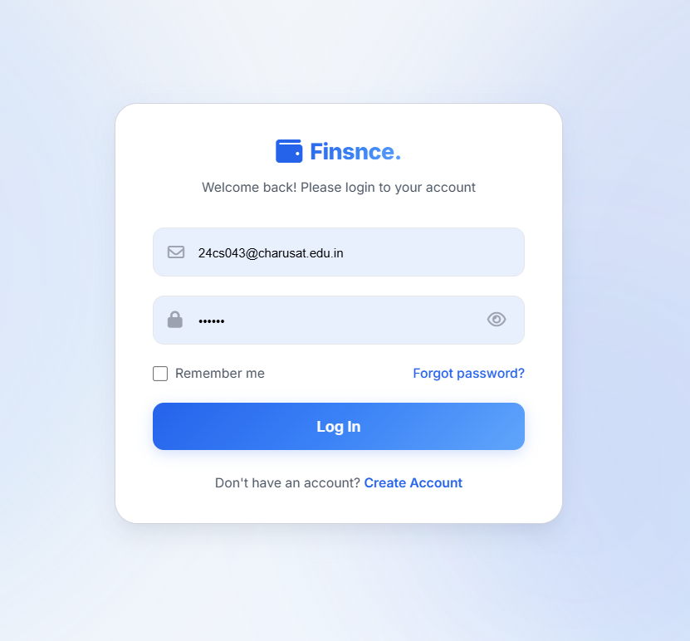

Slide 13
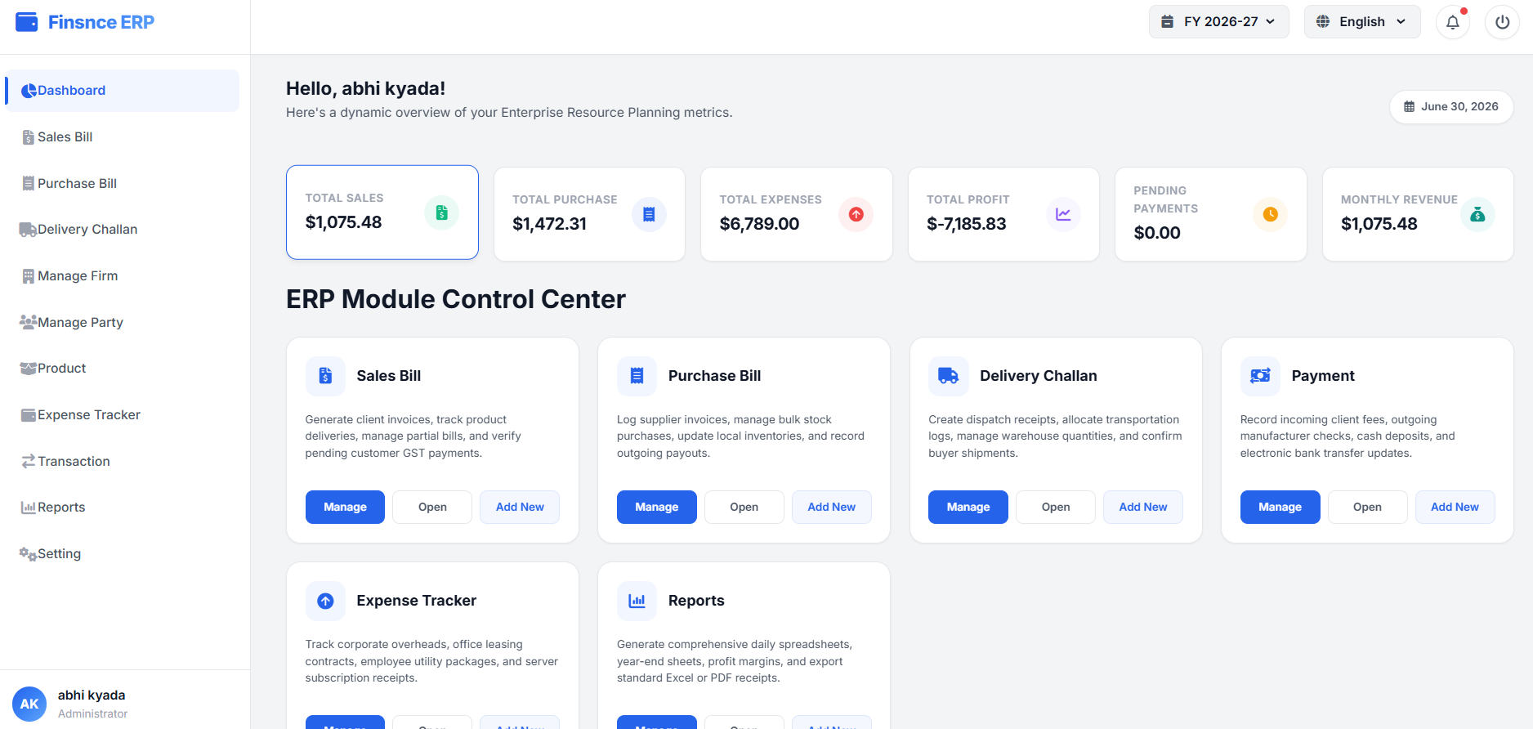

Slide 14
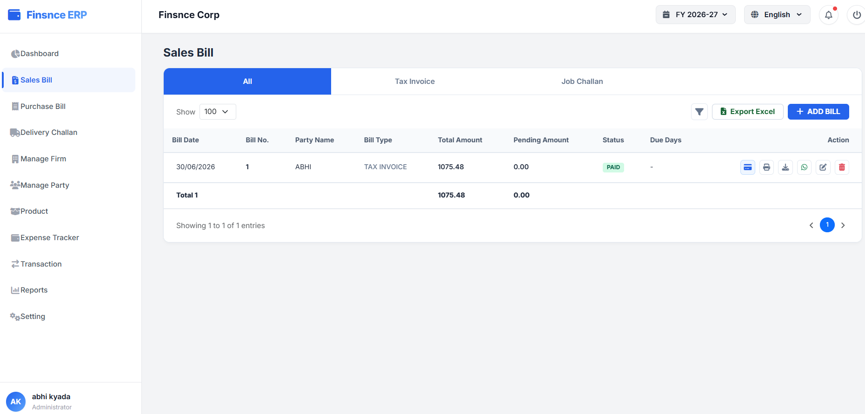

Slide 15
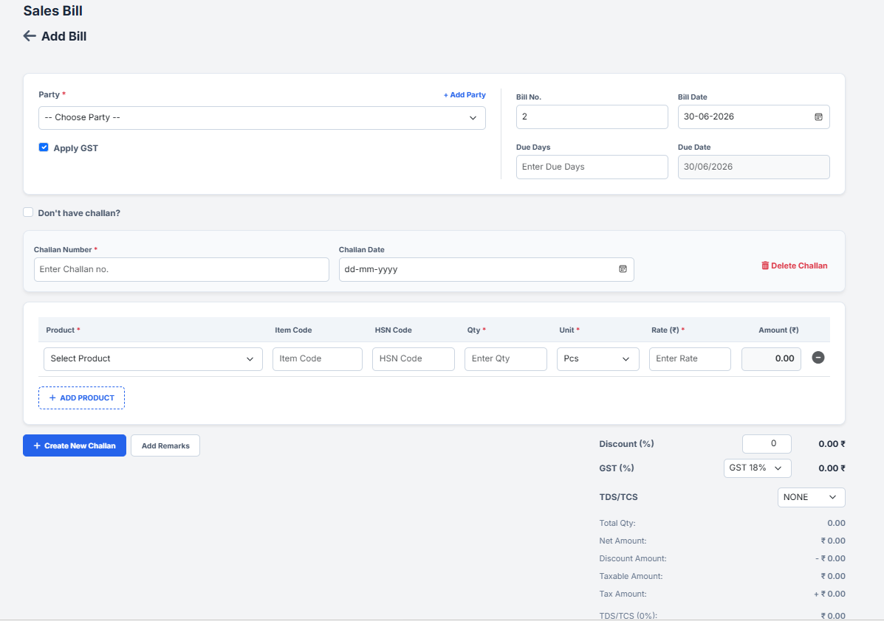

Slide 16
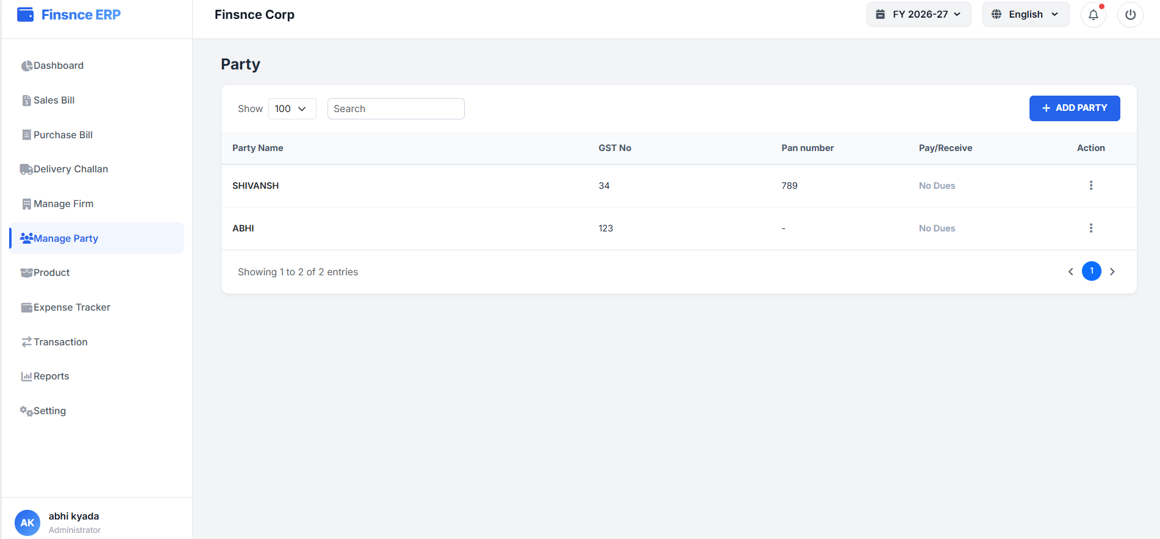
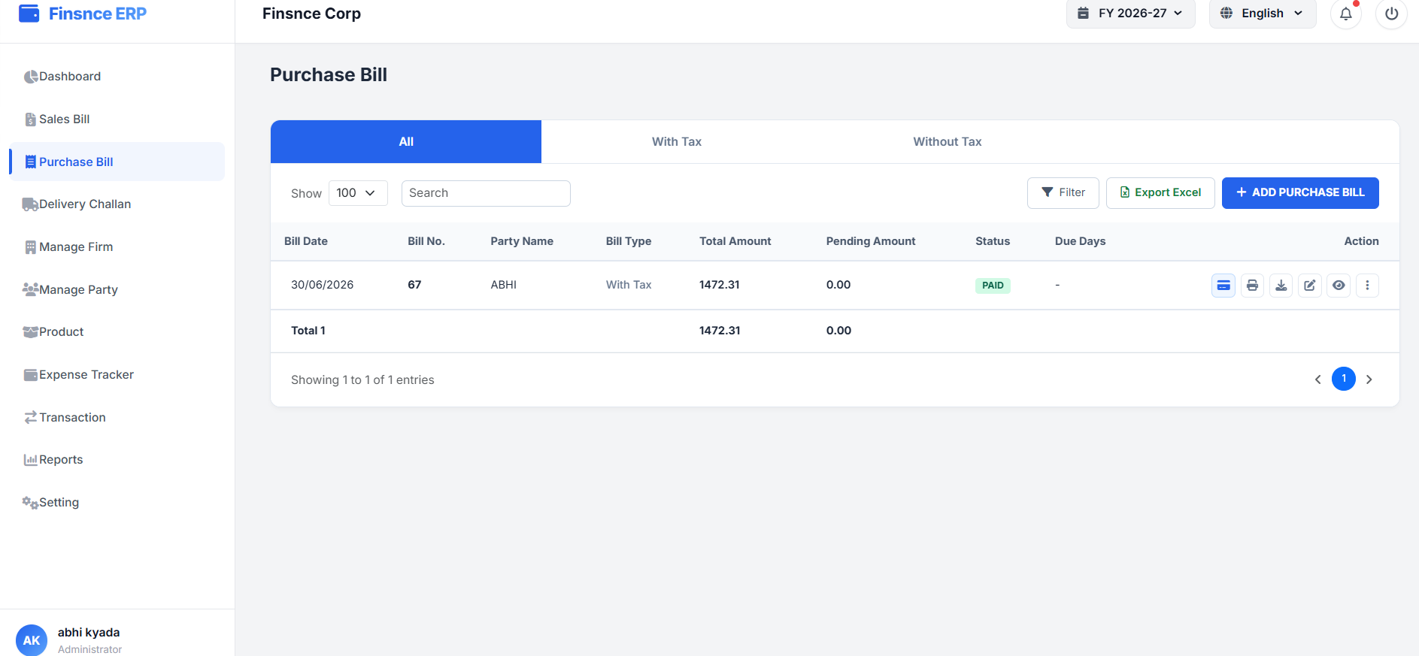
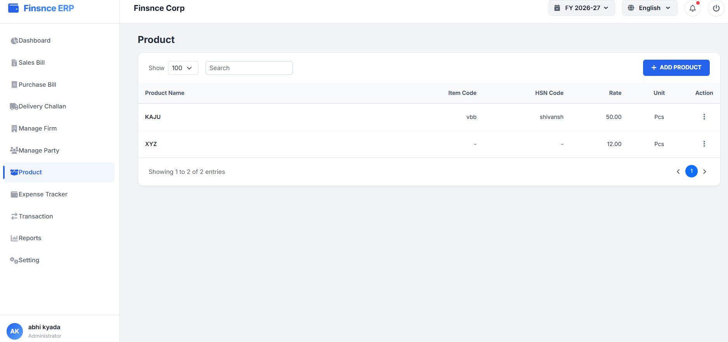
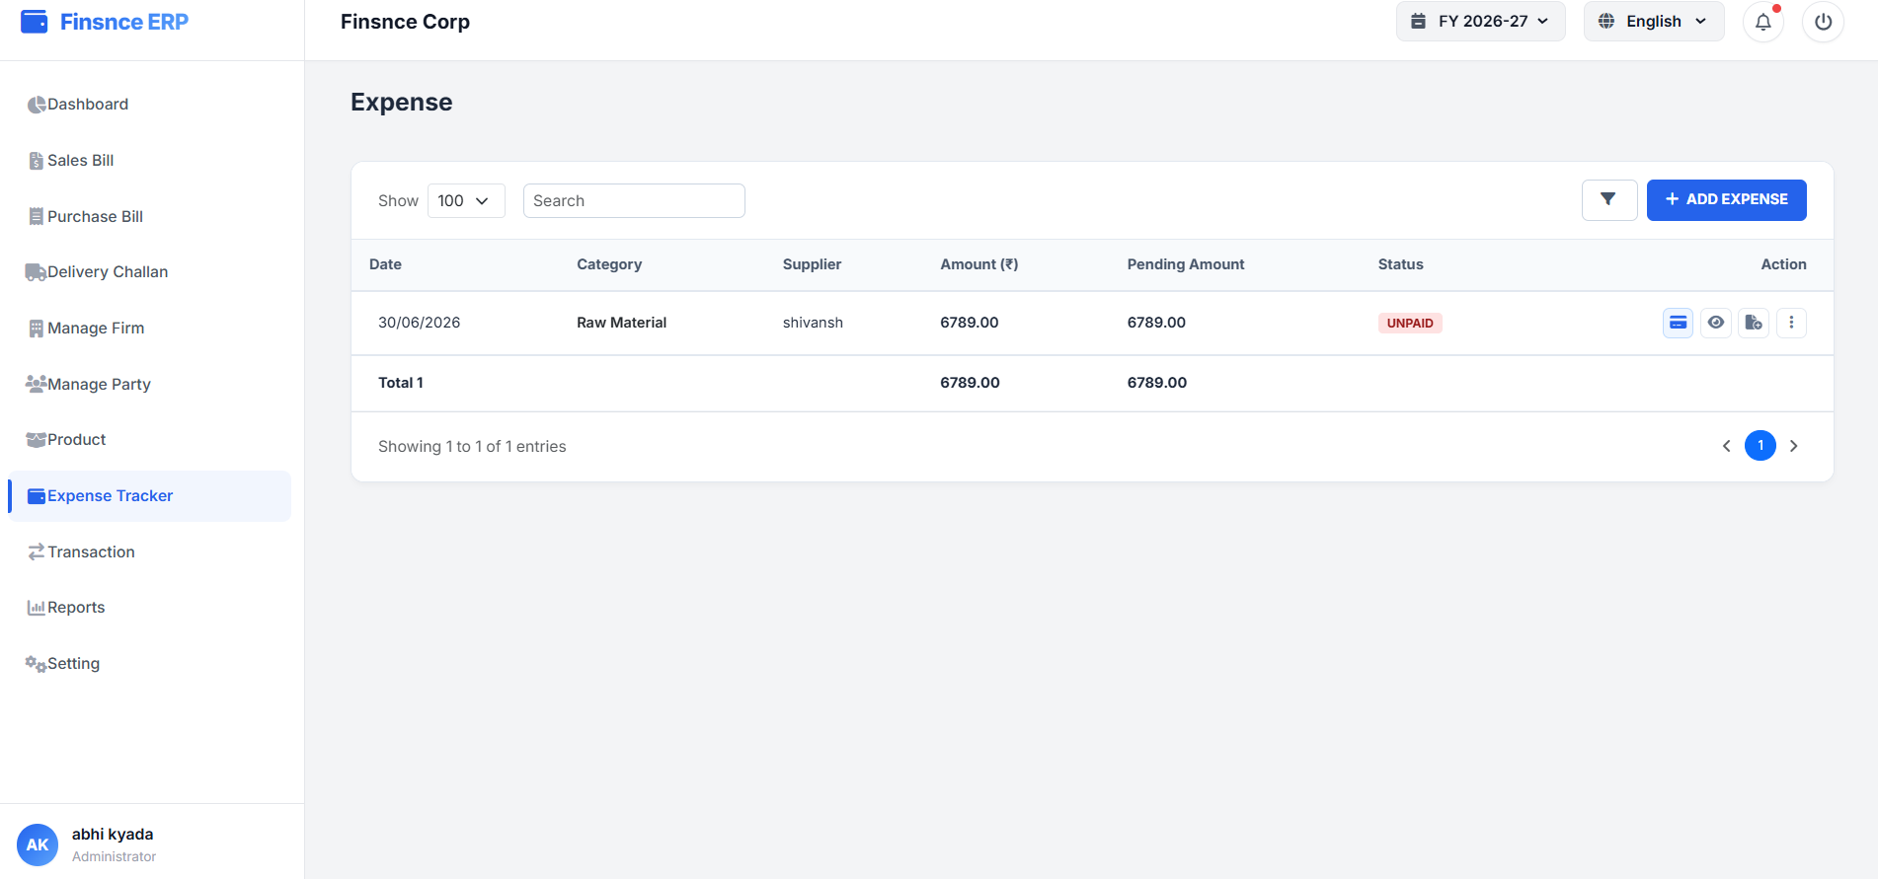

Slide 17
Advantages of Taking this Internship
I gained hands-on experience in web development.
I improved my practical knowledge of HTML, CSS, JavaScript, PHP, and MySQL.
I learned how to build a complete web application from scratch.
I gained experience in both frontend and backend development.
I learned how to design and manage databases using phpMyAdmin.
I improved my problem-solving and debugging skills.
I understood how different web technologies work together.
I gained confidence in implementing real-world projects independently.
I learned how to write clean and organized code.
This internship prepared me for real-world software development and technical interviews.

